Slide 1
Heart Disease Diagnostic Analysis

Slide 2
PROBLEM STATEMENT
Health is real wealth, and during the pandemic, we all realized the brutal effects of COVID-19 on everyone, irrespective of status. The goal of this project is to analyze health and medical data to better prepare for the future.

Slide 3
OBJECTIVE
A dataset was created by considering the health information of 303 individuals. The aim was to analyze this data to identify patterns and insights that could help in predicting and managing heart disease more effectively.

Slide 4
TOOLS & TECHNIQUES USED
ETL Process: Efficient extraction, transformation, and loading of data.
EDA: In-depth analysis to uncover hidden patterns. Visualizations: Engaging and informative charts, graphs, and interactive features to make data interpretation easy and intuitive.

Slide 5
MAIN KPIS
In this project I will note create any KPI.
Instead KPI I created slicers like Gender & Heart Daises.

Slide 6
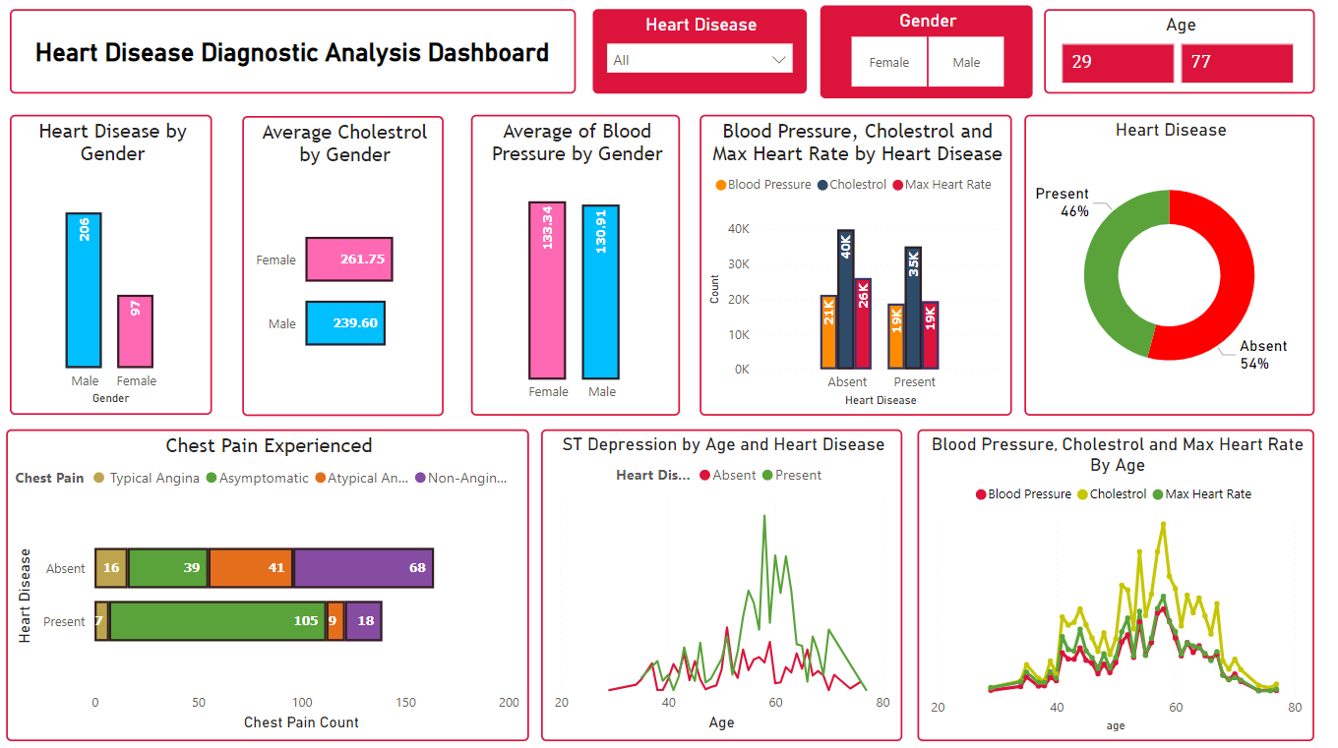
DASHBOARD

Slide 7
INSIGHTS
Gender and Heart Disease: The dashboard shows a higher percentage of people with heart disease identified as male in the data set (54%) compared to female (29%). However, it is important to note that the data also has a higher number of males overall (77 vs 29). More balanced data would be needed to draw stronger conclusions about gender as a risk factor.
Blood Pressure and Cholesterol as Potential Risk Factors: The data suggests that individuals with heart disease tend to have higher blood pressure and cholesterol than those without heart disease.
Blood pressure is higher for those with heart disease (105) compared to those without (68).
Cholesterol levels are also considerably higher in those with heart disease (greater than 40K) vs (around 20K).
Chest Pain: Interestingly, more people without heart disease (39) reported chest pain than those with heart disease (16). This highlights the importance of seeking medical attention for any concerning symptoms, as chest pain can have various causes.

Slide 8
GITHUB & LINKEDIN
https://github.com/Kavan243/Heart-Disease-Diagnostic-Analysis
https://www.linkedin.com/posts/kavan-prajapati24_heartdisease-hearthealth-healthcare-activity-7218562496075354112-8Bz1?utm_source=share&utm_medium=member_desktop

